Slide 1
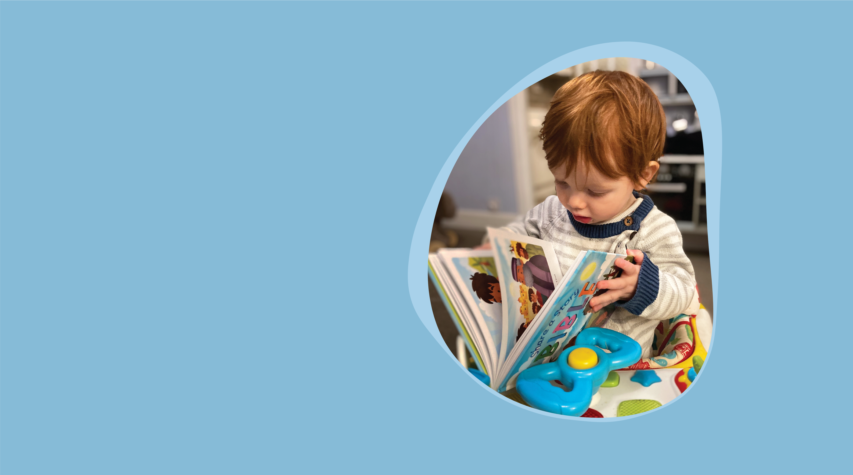
Fewer than half of children under three are read to every day
Help us to change that
A Bible for Every Child
Visit bible.scot/bfb today

